Slide 1
ORL 5524-Session 5.0
Instrument Design and Validation
Madhabi Chatterji, Ph.D.
Professor of Measurement, Evaluation and Education
Director, Assessment and Evaluation Research Initiative (AERI)
Teachers College, Columbia University

Slide 2
AGENDA
Contd. from last week….
Validity and types of validity evidence (handout and slides from last week)
Reliability and types of reliability evidence (new handout and Reliability slides from last week)
Applying the Process Model—Case 1
( Chatterji & Lin, 2016)

Slide 3
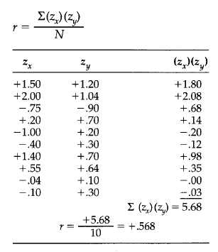
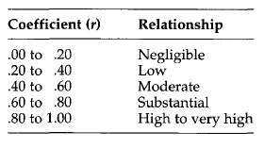
Calculating and interpreting the Pearson correlation coefficient in validity and reliability evaluations
NOTE:
Different interpretive rules for validity coefficients (size and direction is theory guided) versus reliability coefficients must be (positive, size approacing .90 or better desirable, minimum cut point at .70)

Slide 4
Reliability Concepts from Classical Test Theory
Recall from earlier sessions : The scores should give us reliable information. Following use of an assessment instrument on individuals, the results must be both precise and replicable under different circumstances and conditions.
Reliability refers to the degree of consistency in the scores/results/data that an assessment instrument yields, under different conditions. The sources of inconsistency are attributed to random error.
Theory:
Classical Test Theory (CTT) holds that there is always some random error in test scores.
X=T+E
In reliability estimations from a CTT perspective, the E is random error of scores or measures.
We cannot gauge the amount of random error in a given individual’s score. But, using probability theory on how random variables behave, if we can calculate the Observed Score (σ_{X}) variance in a group of people, we can then estimate the Error variance (σ_{E}). The variance of True Scores (σ_{T}) is obtained trough subtraction, as follows:
σ_{X}= σ_{T} + σ_{E}

Slide 5
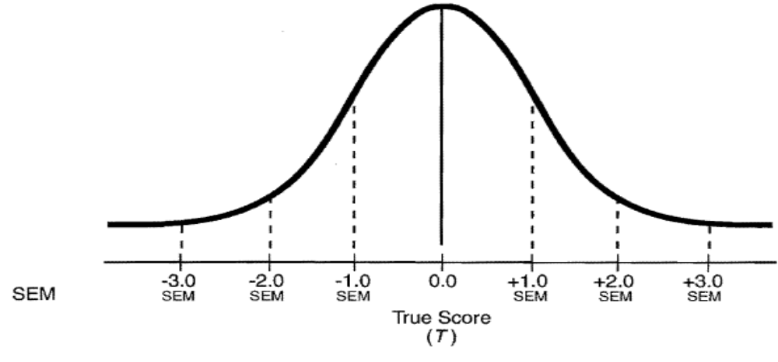
Normal Distribution of Errors of Measurement
68%
95%
99%
Hypothetical Distribution of a Person’s Observed Scores (X) Resulting from Numerous
Repeated Measurements
X = T + E
There is a 68% chance that a person’s T would lie between + 1 SEM units
There is a 95% chance that a person’s T would lie between + 1.96 SEM units
There is a 99% chance that a person’s T would lie between + 5.28 SEM units

Slide 6
Quantitative Estimates of Reliability
Under the CTT framework, two major methods for estimating degrees of reliability in scores/measures:
Standard Error of Measurement
(SEM, σ_{E})
Reliability Coefficient (r_{XX´})
_{(Inverse relationship)}

Slide 7
How to Calculate Standard Error of Measurement (SEM)= SEM = s_{X} √(1.00 – r_{XX´} )
Case 1:
    r_{XX´} = .60
    s_{X} = 5.0
    SEM = 5.0 √(1 – .60)
    = 5.0 √.40
    = 3.162
Case 2:
    r_{XX´} = .95
    s_{X} = 5.0
    SEM = 5.0 √(1 – .95)
    = 5.0 √.05
    = 1.118

Slide 8
In practical design terms: Sources of Random Error
When assessment data are collected under real-time conditions, there could be multiple sources of random error or causes for unreliability that seep into scores/measures.
Domain-sampling issues: Poor or limited sampling of items and behaviors from specified construct domain (domain-sampling error caused by too few items or tasks on the instrument)
Examinees: Random variability in the behaviors of examinees /respondents to an assessment (fluctuating focus, motivation, illness, etc.)
Assessment conditions: Random errors introduced through a poorly designed or administered assessment, such as, poor directions, randomly variable times/time limits,or proctor behaviors/administration conditions. Assessment environment or conditions allow random distractions.
Performance assessments: Random variability in observer, rater or examiner behaviors (applies to assessments that incorporate human judges/raters)

Slide 9
CTT--Types of Reliability Estimates and Procedures for Reliability Estimation
Test-Retest Reliability
Errors related to occasion or time of assessment
Question: Holding all else constant, to what extent would the scores be replicable and remain stable within a 10-15 day window, regardless of the time or day of administration of the assessment?
Reliability Coefficient:
Test-retest reliability coefficient r_{XX’,} where Time 1, Time 2 scores are correlated
Data Collection Design: Administer the tool to the same group of individuals, in a longitudinal design with a 10 -15 day time gap, under the same conditions ( all else held constant or controlled). Pearson correlations.
Type of Analyses: Pearson product moment correlation coefficient, or a correlation coefficient for rank-ordered/categorical data.
Why the 2 week window?

Slide 10
Sources of Random Error and Procedures for Reliability Estimation
Parallel Forms Reliability
Errors related to use of parallel forms, randomly sampled items from the same domain (e.g., GRE or SAT with multiple forms, or paper and pencil versus computer-adapted formats)
Question: Would the scores be replicable and remain stable, regardless of the test form or differences in administration format?
Reliability Coefficient: Parallel Forms Reliability Coefficient r_{XX‘,} where Form 1, Form 2 scores are correlated
Data Collection Design: Administer the tool to the same group of individuals, who take both Forms under the same conditions at the same time ( all else remaining the same). Pearson correlations
Type of Analyses: Pearson product moment correlation coefficient, or a correlation coefficient for rank-ordered/categorical data.

Slide 11
Sources of Random Error and Procedures for Reliability Estimation
Internal Consistency Reliability (Within-Person Consistency)
Errors related to sampling behaviors/tasks/items from the domain
Question: Would the scores be replicable, regardless of the items/tasks/behaviors sampled from the domain? Assuming that all items belong to the same domain, do the responses inter-relate sufficiently in the same persons to indicate that they are homogeneous?
Reliability Coefficient: Internal Consistency Reliability Coefficient r_{XX‘,} where responses of items, subsets of items, are correlated
Data Collection Design: Administer the tool to one group of individuals at the same time ( all else remaining the same).
Type of Analyses: Split-half reliability design with Spearman-Brown correction; Cronbach’s alpha reliability estimation for rating scale data; Kuder-Richardson Formula 20
( or 21) reliability estimation for binary data

Slide 12
Sources of Random Error and Procedures for Reliability Estimation
(4) Inter-rater reliability
Errors related to Different Observers, Raters or Examiners
Question: To what extent would the scores be replicable, regardless of the examiner, observer or rater providing the ratings?
Reliability Coefficient: Inter-rater Reliability Coefficient r_{XX}
Data Collection Design: Administer the assessment with different Raters/Examiners providing ratings to the same group of individuals, under the same conditions and at the same time (all else remaining the same).. Pearson correlations, Kappa coefficient or Tau coefficients
Type of Analyses: Pearson product moment correlation coefficient, or a correlation coefficient for rank-ordered/categorical data.

Slide 13
Homework for the next class: Validation (including Reliability Estimation) Plan for your study
Validation Question | Rationale | Evidence Sought | Design/Analytic Method

